Slide 1
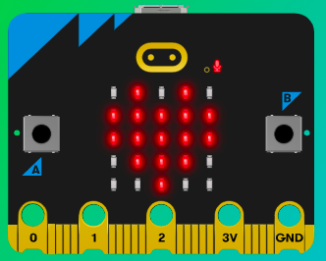
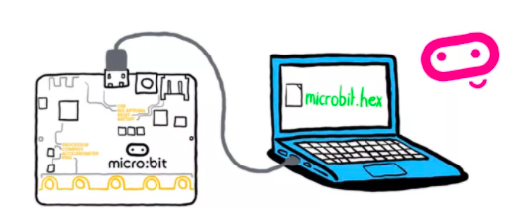
MicroMakers!
KIDS’ MAKER CLUB OF WASHINGTON, DC
Meet Up #21

Slide 2
RECAP!
Notes:
LEDs, Buttons, Light Sensor

Slide 3
RECAP!
Computer Science
Inputs, Processors, and Outputs
Sensors: Magnetometer, Accelerometer
Programming
Programming Languages
Variable
Function
Loops
Syntax
Pseudocode

Slide 4
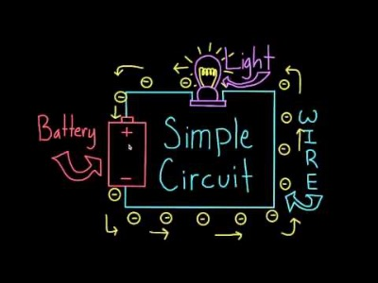
RECAP!
Circuits

Slide 5
Micro:bit Using Pins and Sound Output
Notes:
LEDs, Buttons, Light Sensor

Slide 6

Introduction to Micro:bit Pins

Slide 7
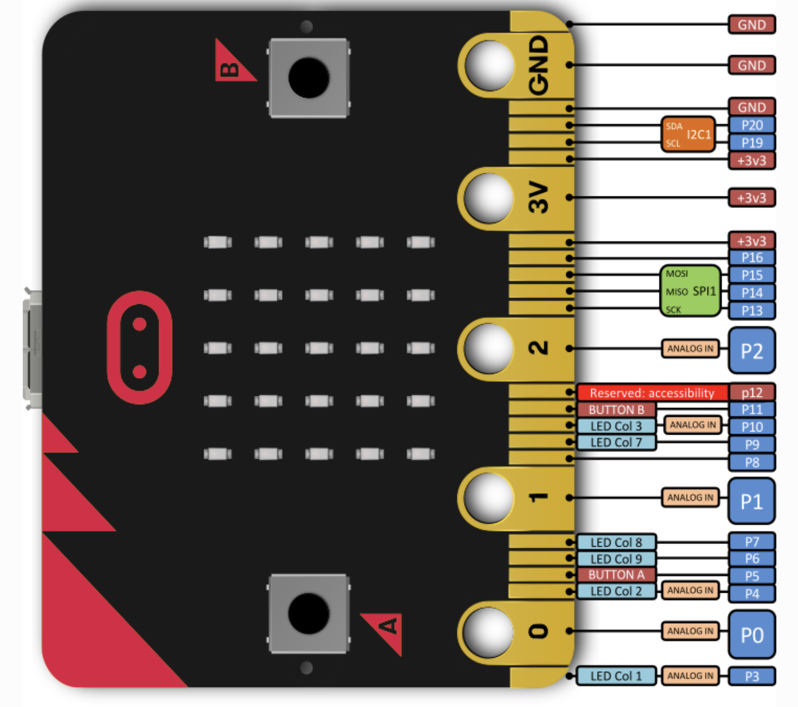
Introduction to Micro:bit Pins

Slide 8
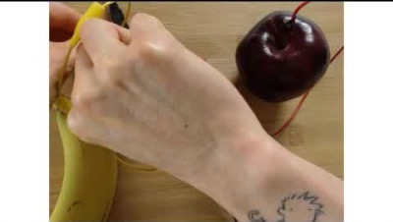
Introduction to Micro:bit Pins: Making Music

Slide 9
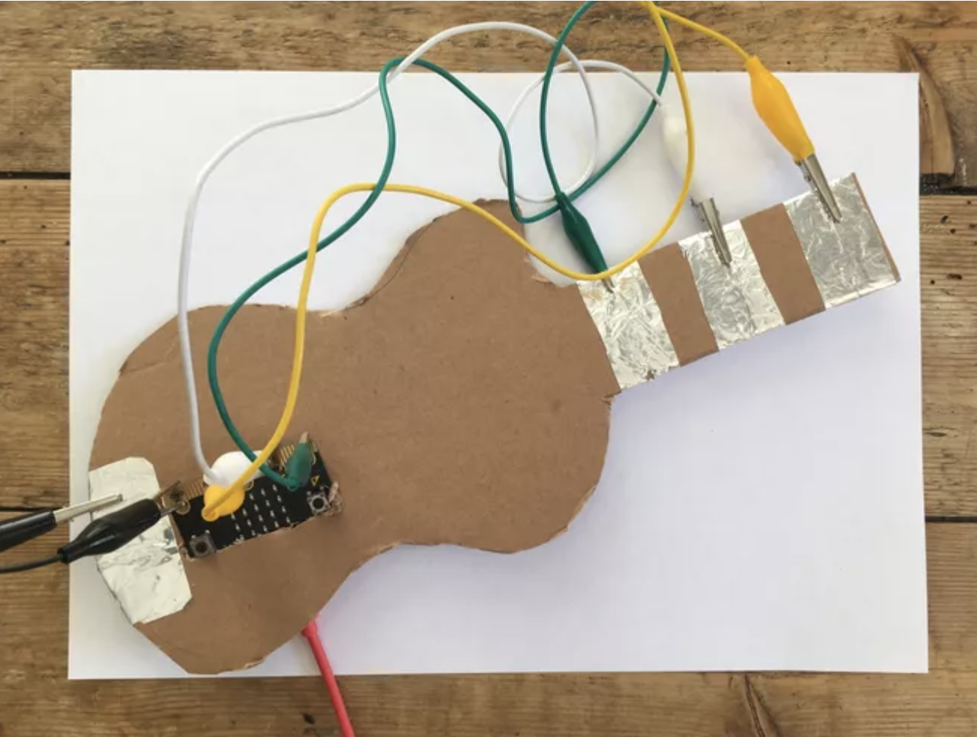
Step 1: The Project
Micro:bit Musical Instrument!
What is it?
Create an electronic musical keyboard that plays at least three notes
What do I need?
Micro:bit with speaker
Cardboard
4 alligator clips
Aluminum foil

Slide 10
Step 2: How Does it Work?
The Basic Keyboard
Make a keyboard from cardboard and foil, like the one in the example.
Connect tin foil pads to the 0, 1, 2 and GND input pins on the micro:bit.
GND is used to complete the circuit.
Your body will become the switch – the link between GND and the three pins, completing the circuits.
When you touch the GND pin and one of the other pins, the program plays the notes F, A or C (or whatever you program) on your micro:bit.

Slide 11
Step 3: Pseudocode It!
When you turn on your micro:bit, your micro:bit should beep and show a picture so you know that your app has started.
On start
Play <sound>
Show <picture>

Slide 12
Step 3: Pseudocode It!
When each pin is activated, a note should play.
When pin P0 pressed
Play tone <note> for <#> beats
When pin P1 pressed
Play tone <note> for <#> beats
When pin P2 pressed
Play tone <note> for <#> beats

Slide 13
Step 3: Make it and Code It!
Build your electronic guitar with cardboard, foil, and alligator clips. You can always decorate it later, after you make it work!
Use your pseudo code to program your guitar to play three notes. Save the bells and whistles for Step 5!

Slide 14
Step 4: Share Your Creation!

Slide 15
Step 5: Improve it!
See if you can use other micro:bit inputs (light sensor, accelerometer, buttons, etc.) to create a wider variety of sounds!
Decorate your awesome instrument!

Slide 16
TIME TO PUT AWAY OUR COMPUTERS and MICRO:BITS
Neat and tidy, please!
Let’s leave this beautiful room as lovely as we found it!

Slide 17

UNTIL NEXT TIME….
MicroMakers!
Slides and Script: Holly Krambeck (learningpython64@gmail.com)

